Slide 1

BAFF-R Targeted CAR-T Cell Immunotherapy: New Hope For Patients With B-Cell Malignancies
Therapeutics
Kayla Underbrink
Seattle Children’s Research Institute
Seattle Children’s Therapeutics: Jensen Lab

Slide 2
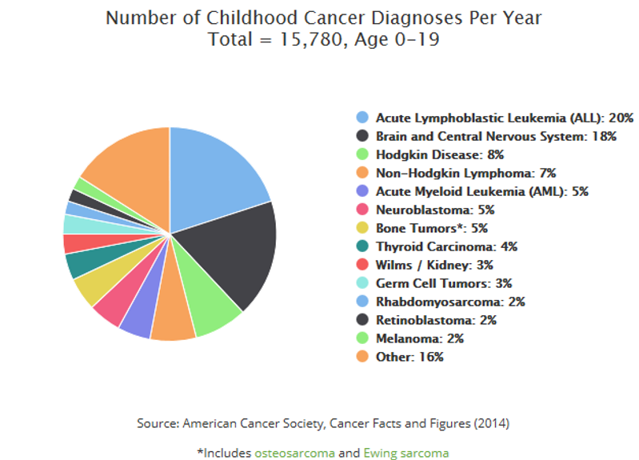
Pediatric Cancer Statistics

Slide 3
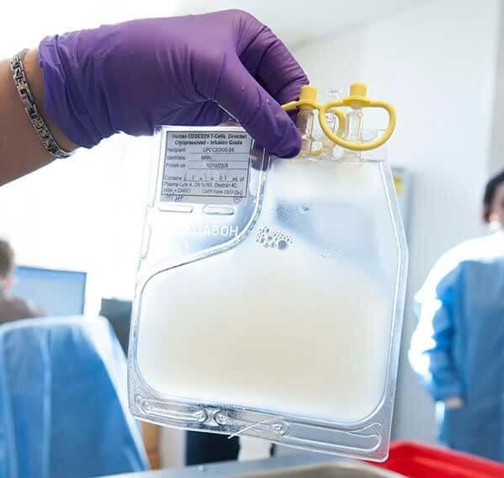
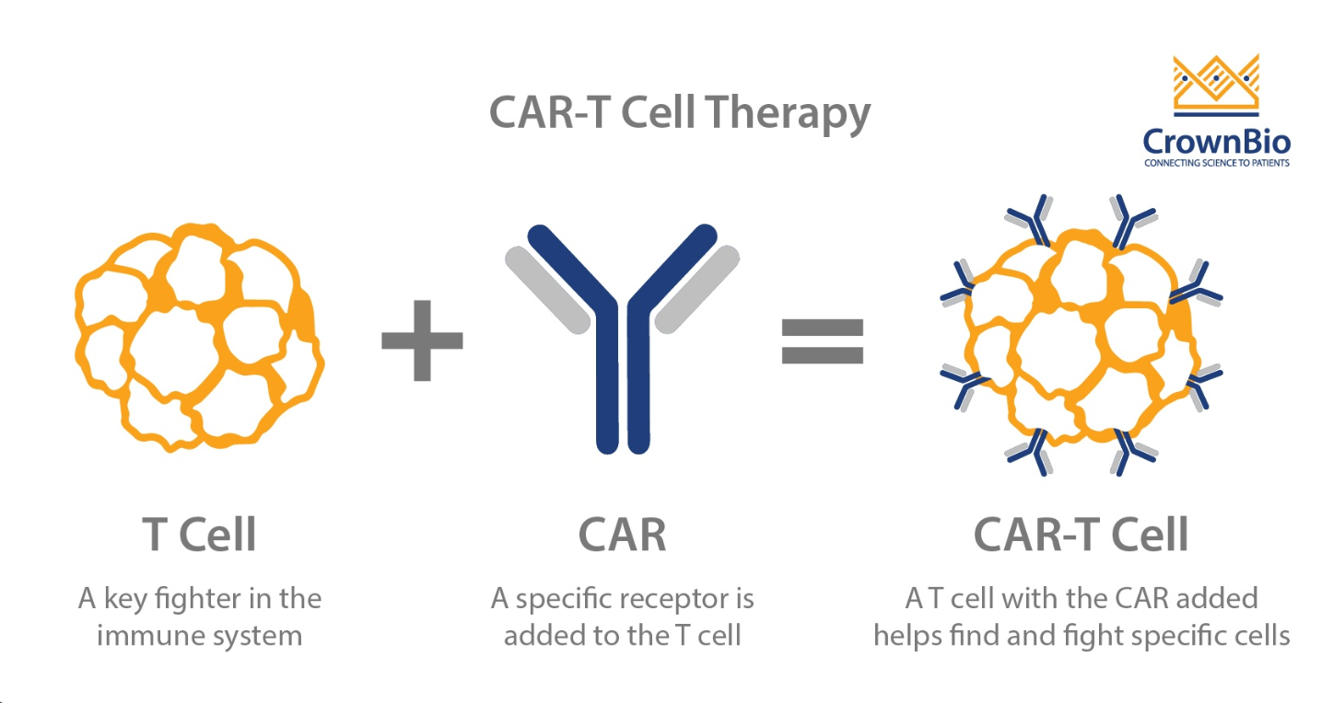

CAR-T Cell Therapy Process
T-Cells Isolated from patient blood
Isolated T-Cells are modified to express CARs T-Cells Isolated from patient blood capable of recognizing cancer cells
Modified T-Cells are expanded
Final T-Cells are infused into the patient

Slide 4
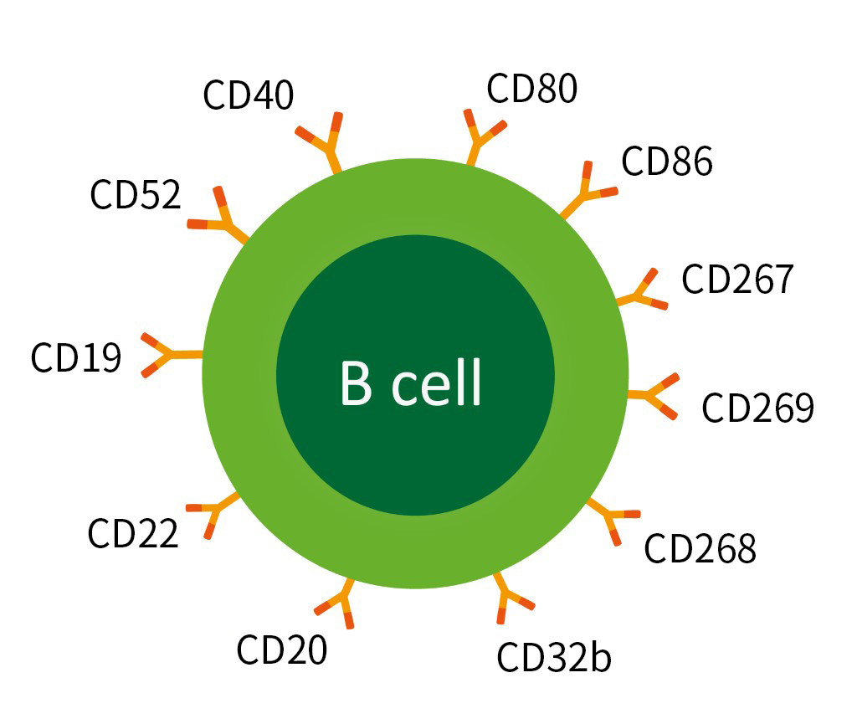


CARs Allow for Antigen Recognition of Specific Cells
CAR T-Cell therapy using CD19 and CD22 has proven to be effective.
Because CD19 and CD22 are not necessary for survival of B-Cells, downregulation of both are potential means of antigen escape.
This downregulation of CD19 and CD22 raised the question: Is there an antigen specific to B-Cells that is required for survival?
If so, antigen escape would not be a possible means for B-Cell malignancy CAR T-Cell treatment avoidance.
CD19 CAR T-Cell
CD22 CAR T-Cell

Slide 5
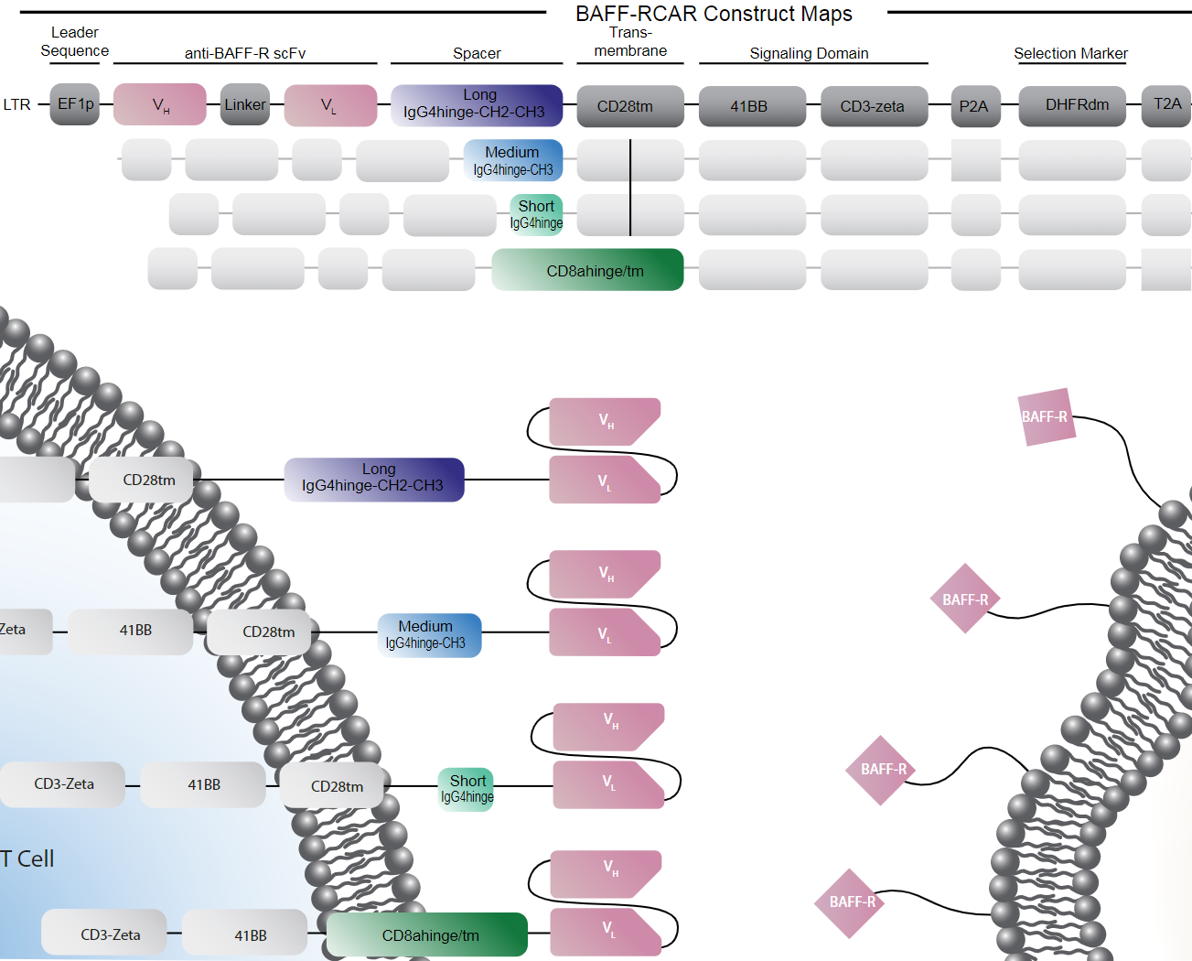
B-Cell Activating Factor Receptor (BAFF-R)

Slide 6
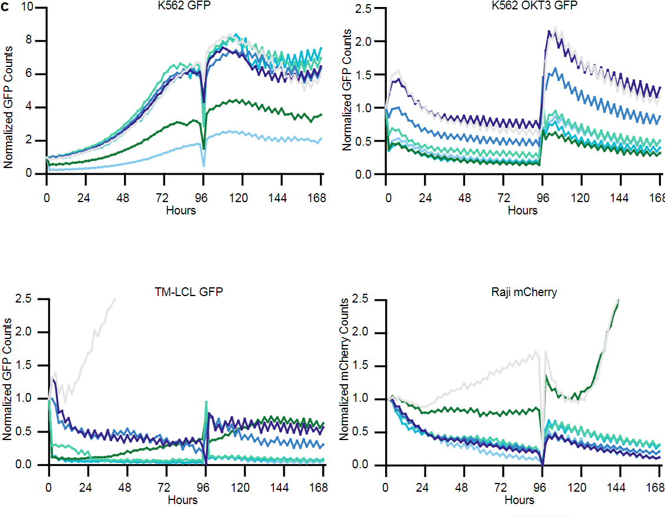
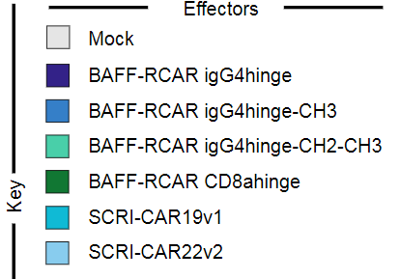
Incucyte Analysis

Slide 7
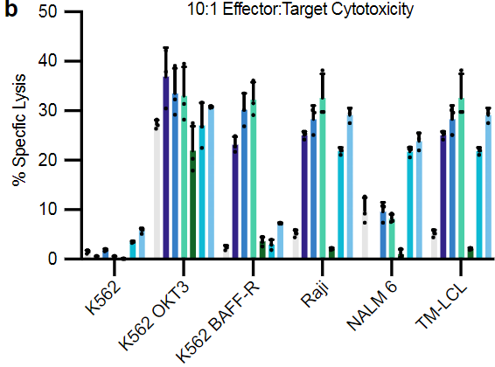
Chromium Release Assay

Slide 8
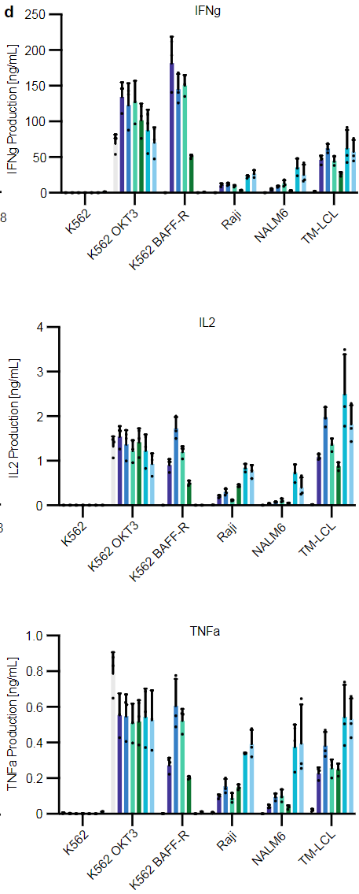

Cytokine Staining

Slide 9
Conclusion slide……

Slide 10
Acknowledgments

